Slide 1
Budgeting

Slide 2
What is a Budget?
A plan for spending and saving money
Most people think budgets are:
Rigid and inflexible
Painful – who wants to eat Top Ramen every night!
No fun!
A budget takes the fun out of money – Mason Cooley

Slide 3
Why Budgets Make Sense
Budgets help you:
Set priorities
Achieve what’s important to you
A good budget is:
Realistic
Ongoing
Clear and easy to use
Notes:
A good budget is:
Flexible: It should change as your needs change.
Ongoing: It’s not a one-time event. A budget should be part of your everyday life.
Clear and easy to use: 12 page spreadsheets are out!

Slide 4
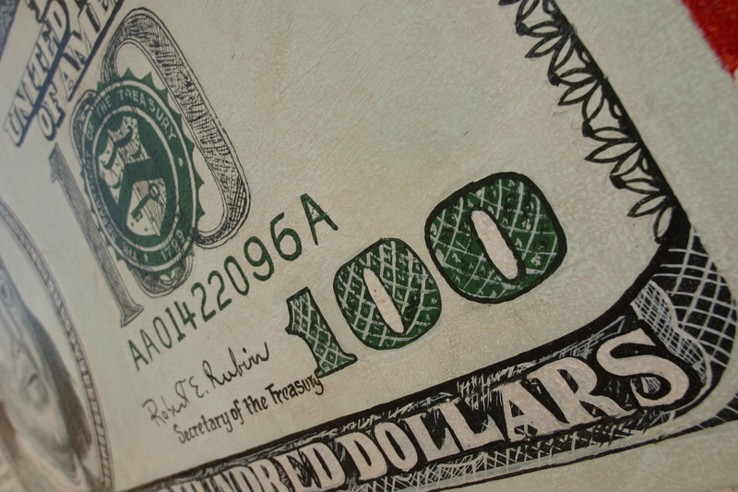
Budget Categories
Income
Gross
Net
Savings
Emergencies
Long-Term
Retirement
Short-Term
Expenses
Fixed
Variable
Discretionary
Notes:
Be clear on what you make and how much you spend.
Anticipate all of your potential expenses.

Slide 5
Income: Money Earned
Gross income: An individual’s income before taxes.
Net income: Income after taxes are paid.
Taxes can range from 15% to 31%.
Notes:
A good budget is:
Flexible: It should change as your needs change.
Ongoing: It’s not a one-time event. A budget should be part of your everyday life.
Clear and easy to use: 12 page spreadsheets are out!

Slide 6
Taxes and Deductions
First job pays $30,000/year.
Your salary is your gross income. Take off at least 25% for taxes and other deductions. That’s what’s left for you to spend.
Example:
Gross salary = $30,000
Minus 25% taxes and deductions - 7,500
Net income $22,500

Slide 7
Savings: Pay Yourself First
Savings: unspent income
Types
Emergencies: Plan to set aside three months’ living expenses
Long-term: Large ticket items (house, car, college)
Retirement: It’s never to early to start
Short-term: Vacation, clothes, new skis
Notes:
A good rule of thumb is to keep at least three months’ worth of living expenses in your savings account just in case you run into an emergency like losing your job or your car breaks down.

Slide 8
Personal Savings Rate Declining
1974 to 1984
10%
1985-1994
Fell to 4.8%
2004
1.8%
2005
-0.5%
2006
-0.7%
Hasn’t been negative since the Great Depression
Notes:
The personal savings rate is, essentially, the amount of after-tax income left once household bills are paid. As a percentage of income, it's declining. The personal savings rate used to be 10 percent of disposable income from 1974 to 1984, according to the Bureau of Labor Statistics. It fell to 4.8 percent by 1994, and was negative for all of 2005. As of January, the personal savings rate was minus 0.7 percent.
Americans not only spent all of their after-tax income in 2005 but had to dip into previous savings or increase borrowing.
The savings rate has been negative for an entire year only twice before — in 1932 and 1933 — two years when the country was struggling to cope with the Great Depression, a time of massive business failures and job layoffs.
One major reason that consumers felt confident in spending all of their disposable incomes and dipping into savings last year was that a booming housing market made them feel more wealthy. As their home prices surged at double-digit rates, that created what economists call a “wealth effect” that supported greater spending
Source: The Bureau of Labor Statistics, March 2006

Slide 9
Start Saving Young!
Save $2,000 per year from age 19 – 26
$1,035,148 by age 65
Save $2,000 per year from age 27 – 65
$805,185 by age 65
Time value of money
Invest fewer dollars at a younger age but have 25% more
Notes:
Save $2,000 per year from age 19 – 26
Invest a total of $16,000 over 8 years and then don’t invest anything else
Save $2,000 per year from age 27 – 65
Invest a total of $78,000 over 39 years
Based on 10% annual rate of return
Source: Smart Women Finish Rich, pg 223.

Slide 10
Expenses
Expense: A cost to meet a need or pay a debt
Types of expenses
Fixed
Variable
Discretionary

Slide 11
Needs vs. Wants
Needs are essentials
Food
Shelter
Clothing
Transportation
Wants are extras
Eating out
Big, expensive house
Shop till you drop
Brand-new or expensive car
Notes:
It’s hard to differentiate between needs and wants. What are some more examples of each?

Slide 12
Fixed Expenses
A cost that occurs regularly and doesn’t vary in amount
Rent
Mortgage
Car payment
Insurance premium
School loans
Others?

Slide 13
Variable Expenses
A cost that occurs regularly but may vary in amount:
Electricity
Water and Garbage
Telephone
Gasoline
Groceries
Others?

Slide 14
Ways to Reduce your Grocery Bill
Make a shopping list
Study grocery ads
Buy store-brand products
Avoid impulse purchases
Learn the basic prices of your favorite foods.
Notes:
c If you buy fewer groceries and eat out more, your food expenses will go up. If you follow these tips, you will reduce your grocery bill and create less variability between your grocery bills from week-to-week.
Make a shopping list
Deviating from your list usually causes you to buy things you don’t really need — and impulse buying can significantly add to your bill. Limiting yourself to one trip a week will also keep you on track with your list. Those extra trips almost always end with more in your cart than you set out to buy.
Study grocery ads
Note what’s on sale, and plan your menu around sale items. Just make sure the sale items you buy are ones you will really use. Pick two stores to shop at — going to more will take too much time and use up any savings in gas money. Make one of the stores an outlet store, and consider shopping there first. Then you can buy at the main grocery store what you couldn’t find at a cheaper price at the outlet store.
Buy store-brand products
Brand-name products almost always cost more than store brands. Shoppers should also realize that store brands are often made by the same companies that make brand-name products. In these cases, the food inside each package is the same; the only difference is the package itself. Coupon clipping might not be as helpful as you think because most coupons are put out by brand-name companies.
Avoid impulse purchases
Don’t push your cart up and down all the aisles; stick to the ones that hold items on your list. In some stores, it’s best to shop the outer perimeter of the store, and avoid the middle aisles where many non-essential items are located. That doesn’t always work, however, as many stores are now sticking impulse-buy items in those outer aisles. At first, you may not even realize it, but think about how often you’ve seen glaze and shortcakes displayed right next to the fresh strawberries.
Learn the basic prices of your favorite foods.
This may take some time and serious study at the grocery store, but it’s the only way to know if something is a bargain. Also, use simple math to figure out if the popular come-on for “10 cans for $10” is really a good deal. And remember: you don’t always have to buy all 10 cans; the price for that kind of deal may be set per can.

Slide 15
Discretionary Expenses
A cost determined by personal wants that may be controlled
Movies, videos, CDs
Sports
Eating out
Grooming and clothes
Concerts and plays
Vacations
Others?

Slide 16
Budget Summary
Establish a budget:
Income
Savings
Expenses
Fixed
Variable
Discretionary
End up with a budget surplus and you’re a success!
Notes:
Set your priorities. What do you want to accomplish with your money?

