Slide 1
Financial Literacy
Student Loans
2014
G
General Audiences
All ages admitted. No content that would be objectionable to most parents. Polite language. No swearing. Only mild violence.

Slide 2
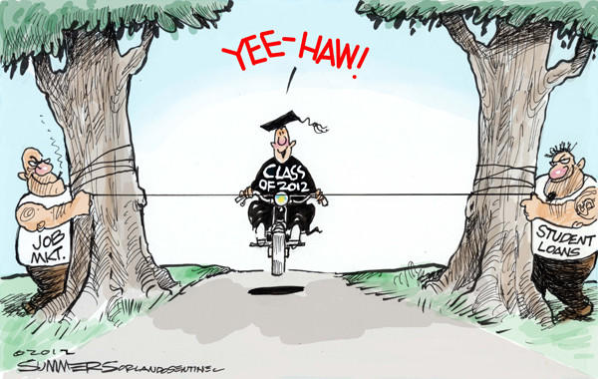

Slide 3
Student Loans
Tiffany Galbavy & Shane Sangrey Director Financial Aid Dean of Academics Program Coordinator

Slide 4
Terminology
Free Application for Federal Student Aid = FAFSA
Cost of Attendance = The student's Cost Of Attendance includes tuition, fees, and standard allocation designed to cover reasonable living expenses while attending school. The cost of attendance is determined by the school using guidelines established by federal regulations. (also known as Cost of Education or Student Budget)
FAO = Financial Aid Office
Unmet need: Any need that remains after aid has been awarded.

Slide 5
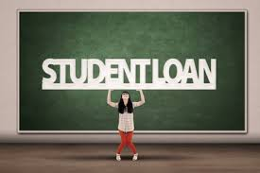
Federal Loans

Slide 6
Background
On January 1, 2011, total US educational debt stood at $1.08 trillion. The average cost of a Bachelor’s degree at a private college or university is $45,000, according to The College Board’s Trends in Higher Education.
Of the nearly 20 million Americans who attend college each year, about 12 million borrow, according to the Almanac of Higher Education. Estimates show that the average four-year graduate accumulates $26,000 to $29,000 in loans, and some leave college with debt totaling in the six figures.

Slide 7
Lifecycle of a Direct Loan
Eligibility
Determined by combining:
Information & awards from FAFSA
Other awards & payments
Limited by the Cost of Attendance

Slide 8
Lifecycle of a Direct Loan
Eligibility
DLs are sent to the Dept. of Ed.
Origination

Slide 9
Lifecycle of a Direct Loan
Eligibility
Funds transmit from
DoEd to school on appointed
disbursement day
Origination
Disbursement

Slide 10
Lifecycle of a Direct Loan
Eligibility
Repayment
Origination
Disbursement

Slide 11
Loan Counseling
www.studentloans.gov
Entrance Counseling
First-time borrowers
Inform them of their rights and responsibilities of taking out this loan
www.nslds.ed.gov
Exit Counseling
All loan recipients that depart from your institution
Graduate, withdraw, transfer, do not return
No Exit Counseling = no transcripts / no diploma

Slide 12
Promissory Note
Document executed by borrower, which spells out the terms & conditions of the loan disbursements, use and repayment
If the note is for multiple loan periods and varying amounts, the lender may elect to have the borrower use a:
Master Promissory Note

Slide 13
Federal Loan Types

Slide 14
Federal Perkins Loan
Oldest active educational loan
Institution administers this loan
Previous allocations came from the Dept of Ed, now schools operate this loan from repaid funds
Fixed 5% interest rate
Repayment begins 9 months after student ceases to be enrolled at least 1/2 time
Minimum payment as low as $30
Maximum repayment term is 10 years

Slide 15
Federal Parent Plus Loan
Federal PLUS Loan is a loan for parents of dependent students
Parent borrower is fully liable for loan
(may require endorser)
FAFSA not required by regulation, but schools can require it if they wish
Eligibility
Parent must be the natural or adoptive parent of the student, or spouse of one of those people
Parent must be a US Citizen, U.S. National or eligible NC
Parent must have no Title IV loans in default
Parent must be credit worthy, or have credit worthy endorser

Slide 16
Federal Graduate Plus Loan
Eligibility (ref. FSA Handbook)
Borrower must complete a FAFSA
U.S. Citizen attending at least half-time, seeking a Graduate or Professional degree
Borrower must pass a credit evaluation
Loan Limits
COA minus other aid

Slide 17
Federal Direct Loan
U.S. Citizen, U.S. National, permanent US Residents & aliens, or Eligible non-citizen (ref. FSA Handbook)
Enroll 1/2 time in a degree seeking program
SAP - Satisfactory Academic Progress
No default / overpayment on any Aid
Register with selective service
Must complete FAFSA

Slide 18
Direct Loans: Sub vs. Unsub
Subsidized DL
(Need-based)
Interest:
ED pays during
In-school
Grace
Deferment
Student pays during
Repayment
Unsubsidized DL
(Non need-based)
Interest:
Student responsible for all
Can be capitalized, or
Student can choose to pay interest

Slide 19
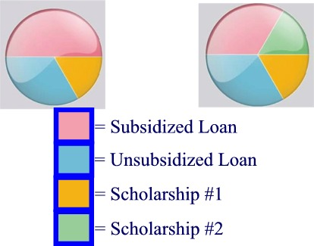
Need vs non-Need
Need-based Financial Aid | Non-Need Financial Aid
Scholarships | Unsubsidized DLs
State & Federal Grants | Private Loans
Subsidized DLs

Slide 20
DL loan limits
 | Combined Sub & Unsub |  | Sub may not exceed
Undergrad Dependent | $31,000 |  | $23,000
*Undergrad Independent | $57,500 |  | $23,000
Grad and Professional | $138,500 |  | $65,500
* And dependent student whose parent is unable to obtain a PLUS loan; denial of parent’s PLUS produces add’l unsub

Slide 21
Interest Rates & Fees
Perkins Loans – no fees
Fixed IR = 5%
Direct Loans – 0.5% orig. fee
Actually 1.5% minus 1% rebate)
Undergrad sub = fixed IR of 4.5%
All other DLs = fixed IR of 6.8%
Direct Parent PLUS / Grad PLUS – 2.5% orig
Actually 1.5% minus 1% rebate)
fixed IR 7.9%
To retain rebates,1st 12 pymts must be on time

Slide 22
Federal Consolidation Loan
Federal education loans that may be consolidated
― FFELP (Federal Family Ed Loan. ― Perkins
― Direct ― HEAL (Health Education Ass. Loan)
No minimum loan amount
Thirty-year repayment (maximum)
Interest rate will be a fixed interest rate, capped at 8.25%
A weighted average is used to figure the interest rate and then it is rounded up to the nearest 1/8 of a percent.

Slide 23
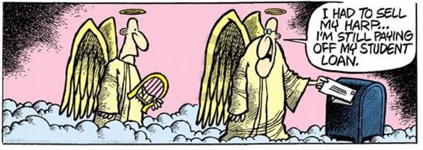

Slide 24
Repayment of Federal Loans
DL
Enters at end of grace period (6 months after student graduates or drops below half-time)
Parent PLUS loan
Enters repayment 60 days after full disbursement (parent can request deferment while student is enrolled at least half-time and during six months following that – up to 25 years to repay)
Grad PLUS loan
Enters when borrower falls below halftime enrollment

Slide 25
Repayment of Federal Loans
All federal loans
Keep loan holders current on student borrower contact information
Contact loan holders as quickly as possible, if a single missed payment is anticipated
Contact loan holders if payments cannot be made
Change in your financial circumstances
Loss of job
Pay off loans as quickly as possible

Slide 26
Repayment of Federal Loans
Single information source for all federal loans – loan holder info, amounts owed including interest accrual
www.nslds.ed.gov

Slide 27
Ways to Repay Federal Loans
Standard – Monthly payment remains consistent for 10 years
Graduated – Monthly payments are lower at first but then increase every 2 years over the 30 yr repayment term
Income-sensitive – Monthly payments are based on your monthly gross income
Extended – Monthly payments over a 25 year plan. Must have a debt greater than $30,000
Income Contingent – payments based on annual calculations and adjusted so as not to cause “undue hardship”; (25 yr. forgiveness)
Income Based Plan - Monthly payments will not exceed 15% of the amount by which your adjusted gross income exceeds 150% of the poverty line for your family size. (25 yr forgiveness)

Slide 28
Deferments
Period of postponing payments
Federal government will pay interest for the borrower on Subsidized DL
Entitlement
Some possible deferments:
- Education
- Peace Corps/ Public Service/ Military
- Economic Hardship

Slide 29
Forbearances
Temporary cessation, reduction, or extension of payments
Student is responsible for interest that accrues
Borrower is willing but temporarily unable to pay

Slide 30
Default
Failure to pay back student loan
Student is considered in default after being delinquent for 270 days; lender may file claim as early as day 271
Student is susceptible to wage garnishment, seizure of income tax refunds, lottery winnings, license non-renewal, sued by DOE
Student not eligible for fed. financial aid; 7-year damage to student credit history
Bankruptcy? Student loans are not exempt from you claiming bankruptcy. You must pay it back.

Slide 31
Private (Alternative) Loans
Designed to bridge the gap between other aid and total college costs
Interest rates from 5% - 18%
Origination and repayment fees vary
Co-borrower requirements (underwriting)
Most now school-certified (lower repayment risk)
Self-Certification Form

Slide 32
Lifecycle of a PVT Loan
Eligibility
Private Loan process is
a bit more complicated
& time consuming
Origination

Slide 33
Lifecycle of a Direct Loan
Eligibility
Funds transmit from
private lender to school on
appointed disbursement day
Origination
Disbursement

Slide 34
Lifecycle of a Direct Loan
Eligibility
Repayment
Origination
Disbursement

Slide 35
Repayment of Private Loans
Keep loan holders current on student borrower contact information
Contact loan holders as quickly as possible, if a single missed payment is anticipated
Contact loan holders if payments cannot be made
Change in your financial circumstances
Loss of job
Pay off loans as quickly as possible

Slide 36
Resources
FAFSA.ed.gov
Federal Student Aid (studentaid.ed.gov)
Student Loan Borrower Assistance Project (www.studentloanborrowerassistance.org)
Federal Student Loan Consolidation (loanconsolidation.ed.gov)
US Department of Education’s Debt Collection Service (www.ed.gov/offices/OSFAP/DCS)
FSA Ombudsman (www.ombudsman.ed.gov)
PSL Ombudsman (www.consumerfinance.gov)

Slide 37
Most important thing to remember!!! -APPLY FOR SCHOLARSHIPS TO AVOID Loans!!!!!!!!!

Slide 38
Questions ???????
Tiffany or Shane

